Slide 1
Cyclistic Case Study
Insights and Solutions
from June 2022 to May 2023
Marcelo Schiavo
July 7, 2023

Slide 2
Summary
Business Tasks
Insights
Conclusions
Recommendations

Slide 3
Business Tasks
Business Task 1
Business Task 2
Business Task 3
Question 1: How do annual members and casual riders use Cyclistic bikes differently?
Business Task: 1. Analyse the patterns and behaviors of annual members and casual riders of Cyclicist bikes from June 2022 to May 2023;
Question 2: Why would casual riders buy Cyclistic annual memberships?
Business Task 2: Identifying the key features and benefits of Cyclistic annual memberships that attract casual riders;
Question 3: How can Cyclistic use digital media to influence casual riders to become members?
Business Task 3: Assessing the marketing channels and strategies used to target casual riders.

Slide 4
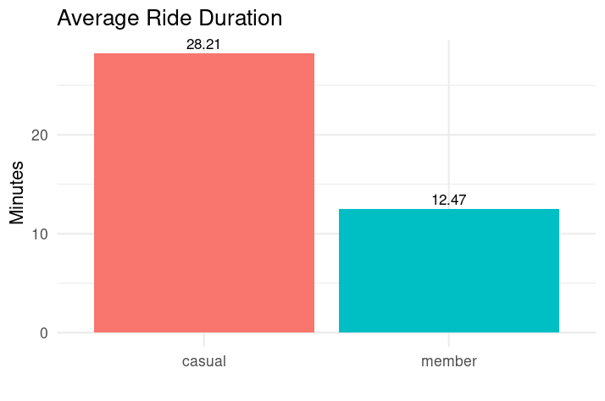
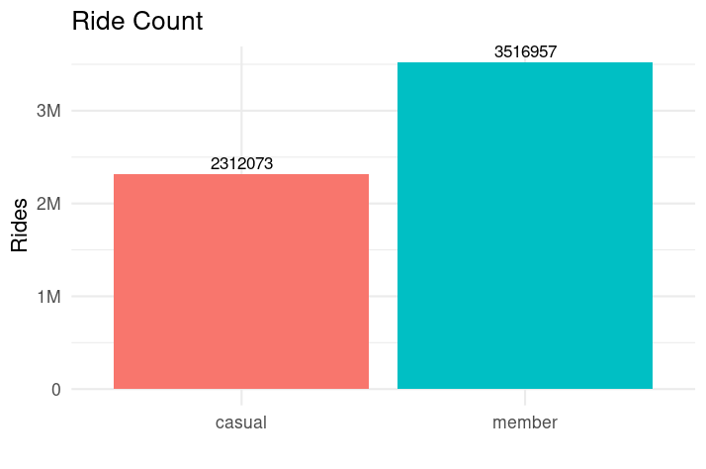
From June 2022 to May 2023, casual riders spent 126.2% longer in their rides with 34.3% less rides started, compared to member riders

Slide 5
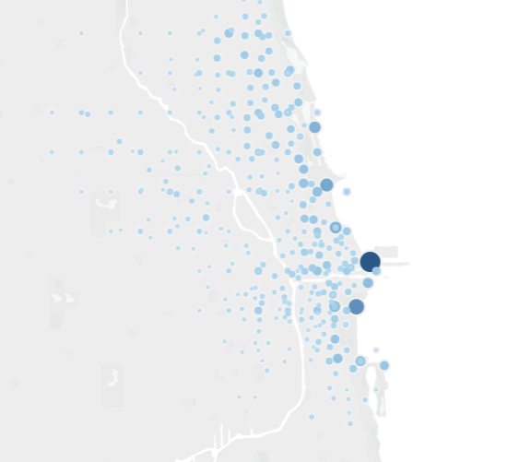
In the same timespan, 0.04% of the geopoints accounted for 47.98% of the rides started by casual riders.
Casual Rides Map Dashboard in Tableau

Slide 6
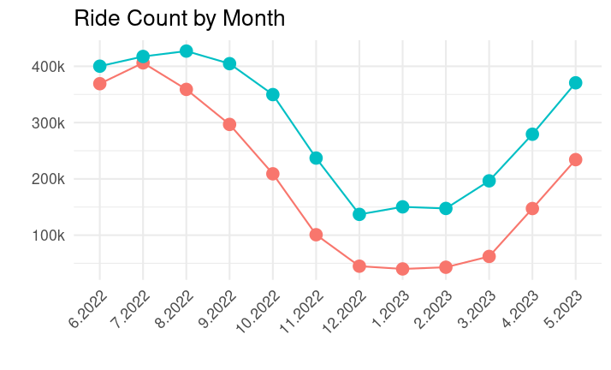
From November to March, casual riders rode under a fifth (17.7%) of their average, while member riders maintained nearly half (43.4%).

Slide 7
Conclusions
Casual riders ride longer but less frequently and in specific geopoints;
November to March are not commonly used by casual riders;
Electric bikes are prefered by casual riders;
During at least half of the year, casual riders maintain the same usage pace as member riders.

Slide 8
Recommendations
Recommendation 1
Focus marketing media strategies on specific geopoints that attract casual riders, with better infrastructure and offering incentives for membership, considering they have the same usage pace of members;
Recommendation 2
Promote the use of electric bikes, preferred by casual riders, highlighting its benefits, in marketing materials and offering special promotions or discounts for electric bike rentals;
Recommendation 3
Intensify marketing efforts, from April to October, more favorable for outdoor activities, with targeted advertising campaigns, social media promotions, and partnerships with local events or organizations.
Recommendation 4
To gain a comprehensive understanding, it is advisable to collect and analyze additional data, particularly by tracing the usage history of individual casual riders and incorporating external data sources.

Slide 9
Appendix
Repository in Github with source files and roadmap: www.github.com/marcelofschiavo/gdca_cyclistic_casestudy

